Slide 1
Dynamics Of Celestial Bodies
Numerical Solutions With C++
Taylor Larrechea - March 12, 2026

Slide 2
About Me
Academic
Graduated from CMU with B.S in Physics and Minor in Mathematics in 2020
Attended graduate school at The University of Oklahoma from 2021 to 2022
Graduated from CU Boulder with B.S in Computer Science in 2024
Published paper to APS with Dr. David Collins in December 2025
Professional
Formulation Scientist at Mesa Lavender Farms from June 2020 to February 2021
Customer Engineer at Applied Materials from October 2022 to May 2025
Junior iOS Engineer as contractor at Vivint from June 2025 - Present

Slide 3
Agenda
Background Of Project
Motivation For Refactoring
The Math
The Physics
Refactored Results
Physics Informed Neural Network
Conclusions
Questions

Slide 4
Background Of Project

Slide 5
Advanced Dynamics - Fall Semester Of 2018
Completed basic implementation of numerical solver with FEDS numerical method
Presented results in Fall Semester of 2019 at CMU
GUI Implementation With RK4 - Fall Semester Of 2023
Created graphical user interface with RK4 solver
C++ Implementation With RK4 - November 2025 to March 2026
Refactored numerical solvers to be in C++ instead of Python
With persistent data
Created N-Body for (hypothetically) infinite number of bodies in system
Created framework for Machine Learning model training from data

Slide 6
Motivation For Refactoring

Slide 7
Initial Refactoring
The Forward Euler Difference Scheme (FEDS) requires a very small time step
This can lead to very long computation times due to small time steps
The Runge Kutta 4 (RK4) numerical method can take in a smaller time step
This leads to less computation time and faster solution times
Python is very, very slow compared to a compiled language like C++
Interpreted language : Writing a book report page by page , Compiled language : Writing a book report after reading the entire book
Persistent data production to be able to review previous computations
Previous implementations did not have the ability to review previous computations
Fast and large data production for ML model training

Slide 8


Let’s Play A Game
Python vs. C++
Two applications written that count to 1 billion
One in Python
One in C++

Slide 9
Algorithms Of Each Language
def count_to(n: int, progress_every: int = 50_000_000) -> float:
start = time.perf_counter()
i = 0
while i < n:
i += 1
if progress_every and (i % progress_every == 0):
elapsed = time.perf_counter() - start
print(f"Reached {i:,} / {n:,} (elapsed: {elapsed:.2f}s)")
sys.stdout.flush()
end = time.perf_counter()
return end - start
double count_to(std::uint64_t n, std::uint64_t progress_every = 50'000'000ULL) {
using clock = std::chrono::steady_clock;
const auto start = clock::now();
std::uint64_t i = 0;
while (i < n) {
++i;
if (progress_every && (i % progress_every == 0)) {
const auto now = clock::now();
const std::chrono::duration<double> elapsed = now - start;
std::cout << "Reached " << i << " / " << n
<< " (elapsed: " << std::fixed << std::setprecision(2)
<< elapsed.count() << "s)\n";
std::cout.flush();
}
}
const auto end = clock::now();
const std::chrono::duration<double> elapsed = end - start;
return elapsed.count();
}

Slide 10
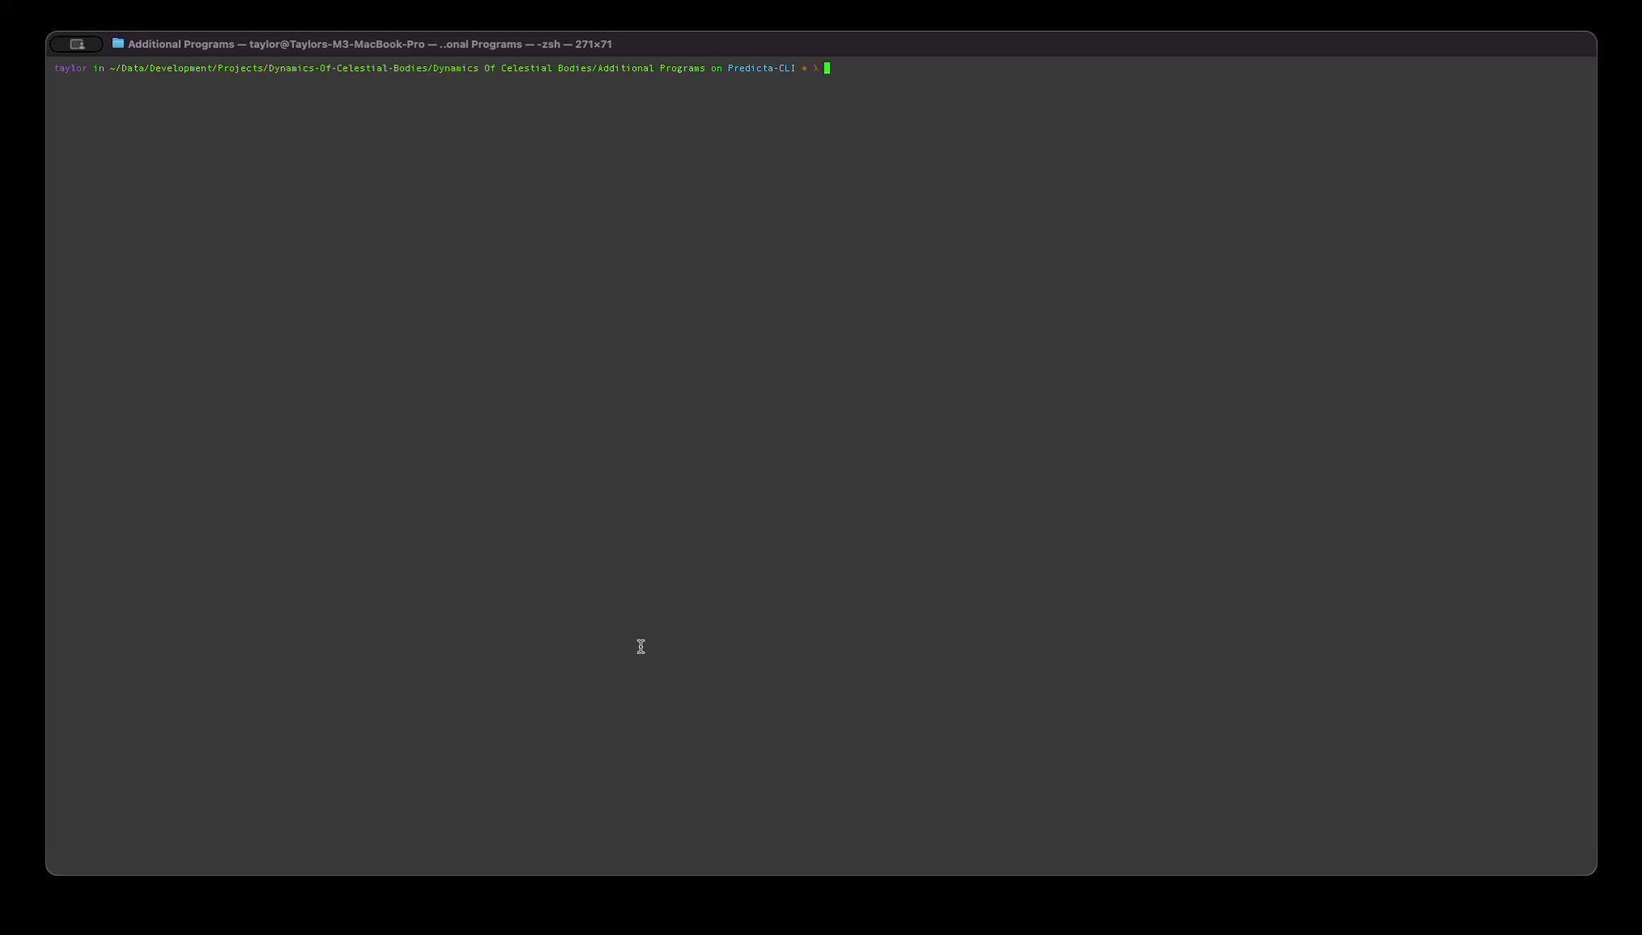
Python

Slide 11
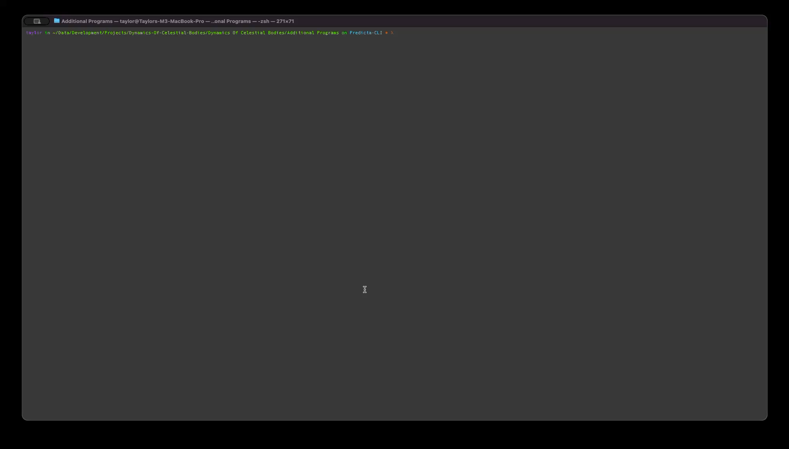
C++

Slide 12
Results
Python
Done. Elapsed time: 46.27 seconds
C++
Done. Elapsed time: 1.18 seconds
C++ is roughly 39.2 times faster at the same task

Slide 13
The Math

Slide 14
How Numerical Methods Work
The TLDR
What are they? Numerical methods are algorithms that approximate solutions to problems that are too hard (or impossible) to solve exactly with algebra/calculus.
Core idea: Replace a continuous problem with a sequence of small, manageable steps that a computer can compute.
How do they work? Start from known information (initial conditions), apply a repeatable update rule, and accumulate results until the desired endpoint is reached.
Step size: Smaller time steps usually give better accuracy, but require more computation; larger steps are faster but can miss important behavior of said system.
Trade-offs: Methods differ in accuracy, stability, speed, and memory use, no single “best” method for every problem.
Validation: Results are checked by testing on known cases, comparing multiple methods, and verifying expected properties.

Slide 15
A Primitive Method: FEDS
The Algorithm
Given an Initial Value Problem (IVP)
$$\frac{dy}{dt}=f(t,y)y(t_{0})=y_{0}$$
pick a step size $h$, $t_{n+1}=t_{n}+h$, and then iterate
$$y_{n+1}=y_{n}+h⋅f(t_{n},y_{n})$$
and that’s it, and it sucks.

Slide 16
A More Robust Method: RK4
The Algorithm
Given an Initial Value Problem (IVP)
$$\frac{dy}{dt}=f(t,y)y(t_{0})=y_{0}$$
pick a step size $h$, $t_{n+1}=t_{n}+h$, and then compute what is called the slopes:
$$\begin{matrix}k_{1} & =f(t_{n},y_{n}) \\ k_{2} & =f(t_{n}+\frac{h}{2},y_{n}+\frac{h}{2}⋅k_{1}) \\ k_{3} & =f(t_{n}+\frac{h}{2},y_{n}+\frac{h}{2}⋅k_{2}) \\ k_{4} & =f(t_{n}+h,y_{n}+h⋅k_{3})\end{matrix}$$
Then update:
$$y_{n+1}=y_{n}+\frac{h}{6}(k_{1}+2⋅k_{2}+2⋅k_{3}+k_{4})$$
And it’s, pretty good.

Slide 17
The Physics

Slide 18
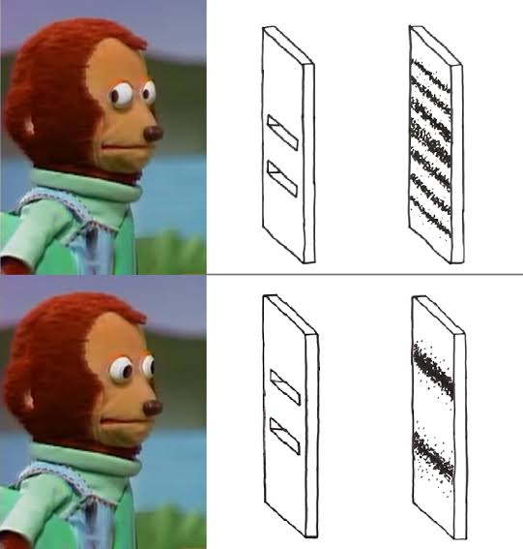
The Physical Systems
Single Body System
Two Body System
Three Body System
N-Body System

Slide 19
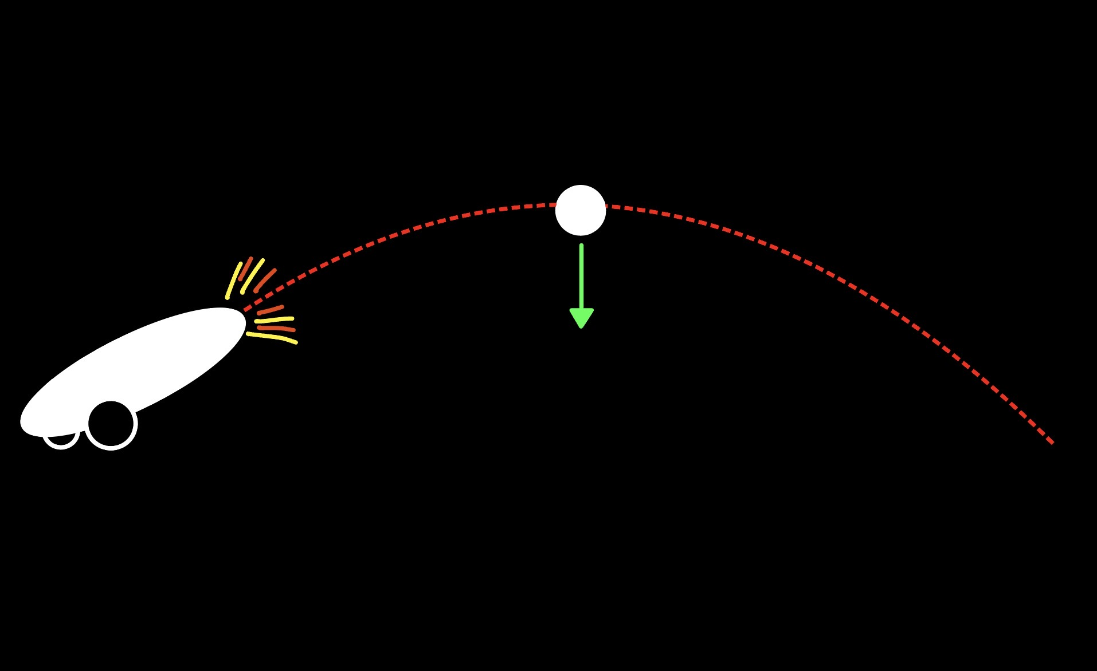
Single Body System (Projectile Motion)

Slide 20
Single Body System (Projectile Motion)
Starting With Newtonian Gravitation
$$F=-\frac{GMm}{r^{2}}$$
Using Newton’s Second Law
$$F=ma$$
Solving For Acceleration
$$a=-\frac{GM}{r^{2}}$$
$r=R+y$ where $R$ is the radius of our body and $y$ is the object’s initial vertical position.

Slide 21
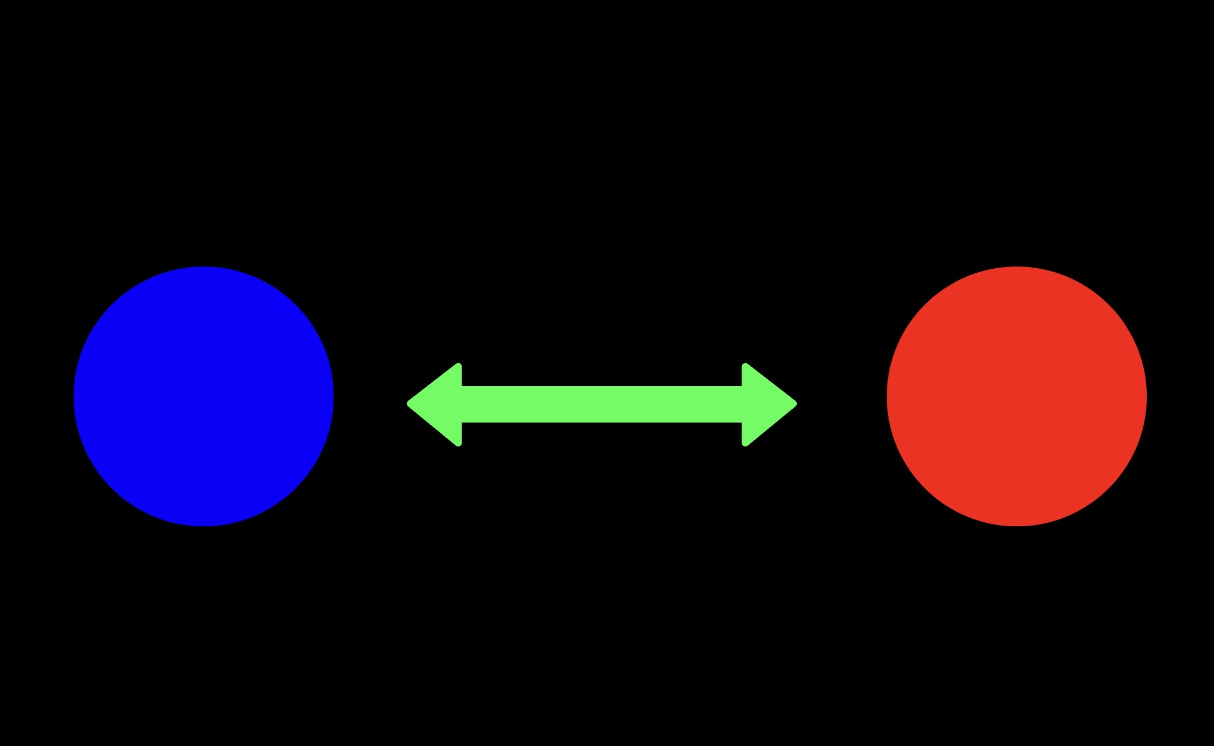
Two Body System

Slide 22
Two Body System
Starting With Newtonian Gravitation
$${\overset{⃗}{F}}_{i}=\frac{Gm_{i}m_{j}}{r_{ij}^{2}}{\overset{⃗}{n}}_{ij}$$
Using Newton’s Second Law
$$\overset{⃗}{F_{i}}=m_{i}{\overset{⃗}{a}}_{i}$$
Extrapolating For Each Body
$${\overset{⃗}{a}}_{i}=\frac{Gm_{j}}{r_{ij}^{2}}{\overset{⃗}{n}}_{ij}$$
Where For Each Body
$$i,j∈\{1,2\},i≠j{\overset{⃗}{r}}_{ij}={\overset{⃗}{r}}_{j}-{\overset{⃗}{r}}_{i}r_{ij}=∥{\overset{⃗}{r}}_{ij}∥{\overset{⃗}{n}}_{ij}=\frac{{\overset{⃗}{r}}_{ij}}{r_{ij}}$$

Slide 23
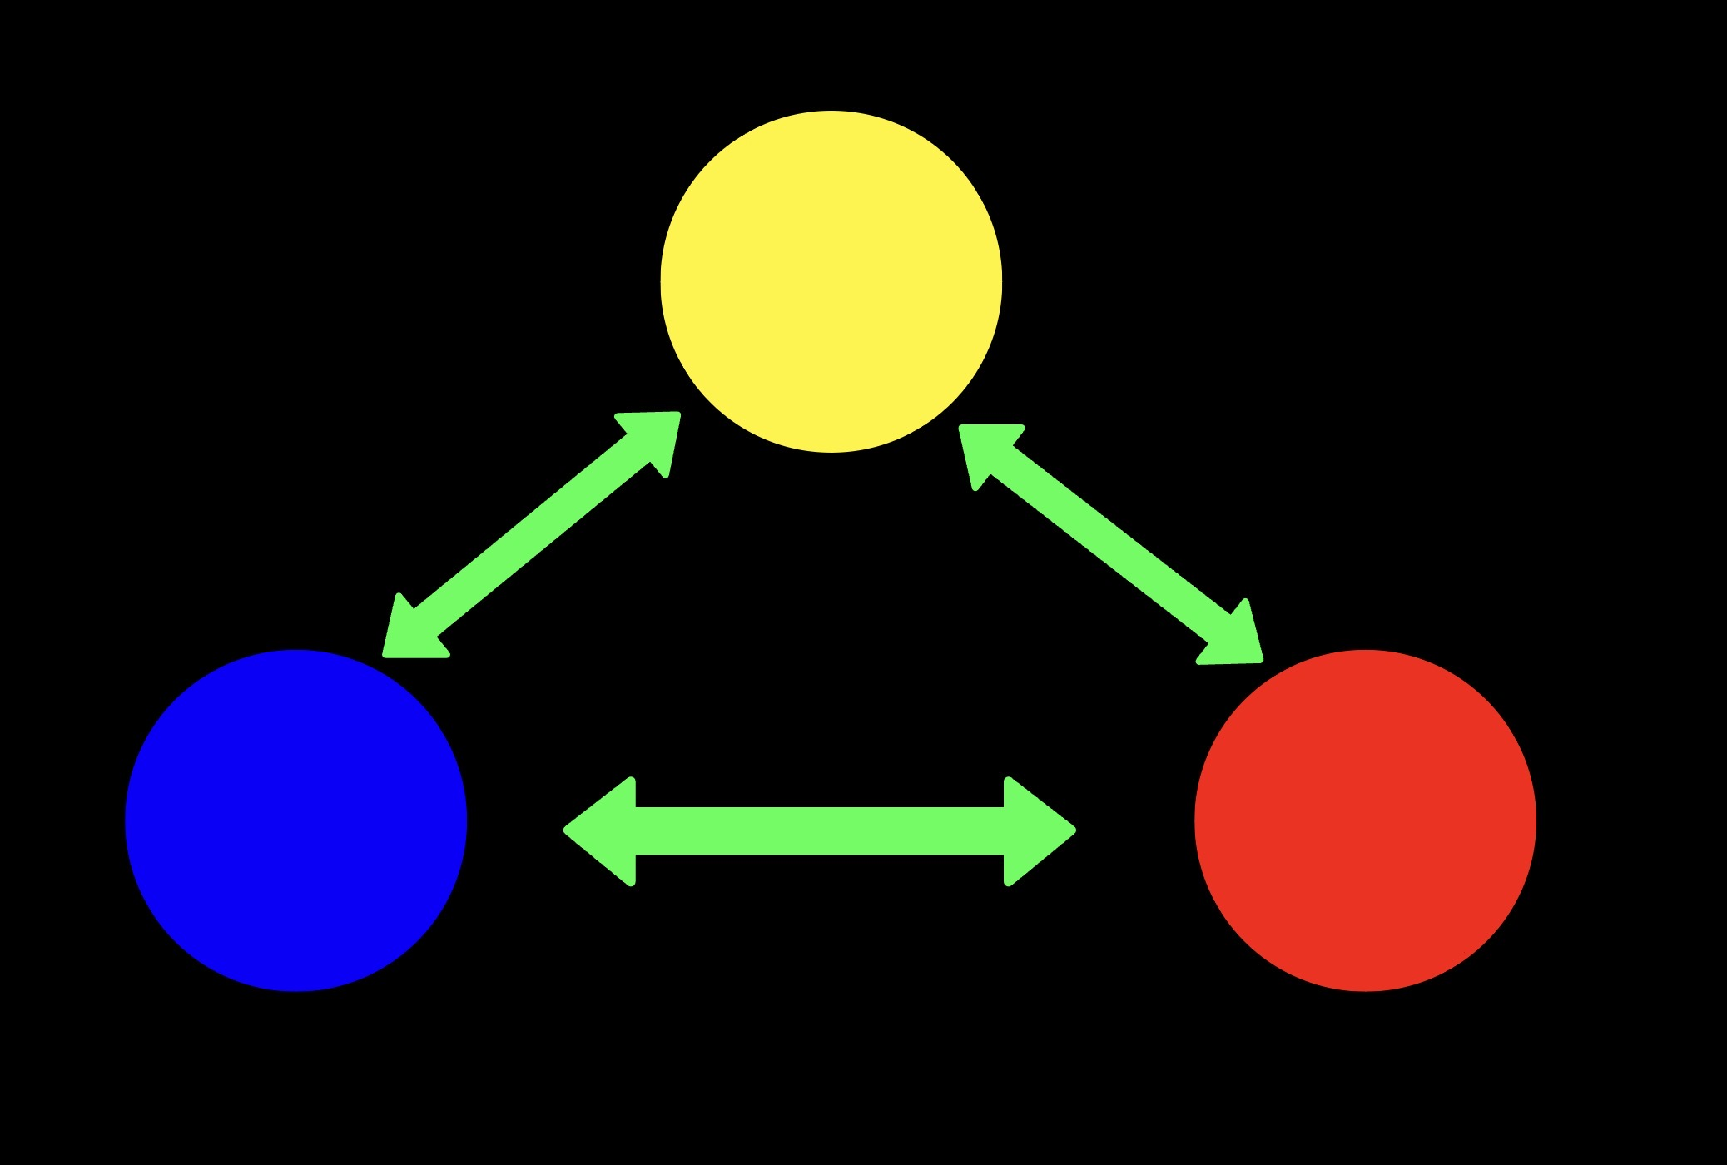
Three Body System

Slide 24
Three Body System
Starting With Newtonian Gravitation
$${\overset{⃗}{F}}_{i}=\frac{Gm_{i}m_{j}}{r_{ij}^{2}}{\overset{⃗}{n}}_{ij}+\frac{Gm_{i}m_{k}}{r_{ik}^{2}}{\overset{⃗}{n}}_{ik}$$
Using Newton’s Second Law
$$\overset{⃗}{F_{i}}=m_{i}{\overset{⃗}{a}}_{i}$$
Extrapolating For Each Body
$${\overset{⃗}{a}}_{i}=\frac{Gm_{j}}{r_{ij}^{2}}{\overset{⃗}{n}}_{ij}+\frac{Gm_{k}}{r_{ik}^{2}}{\overset{⃗}{n}}_{ik}$$
Where For Each Body
$$i,j∈\{1,2,3\},i≠j{\overset{⃗}{r}}_{ij}={\overset{⃗}{r}}_{j}-{\overset{⃗}{r}}_{i}r_{ij}=∥{\overset{⃗}{r}}_{ij}∥{\overset{⃗}{n}}_{ij}=\frac{{\overset{⃗}{r}}_{ij}}{r_{ij}}$$

Slide 25
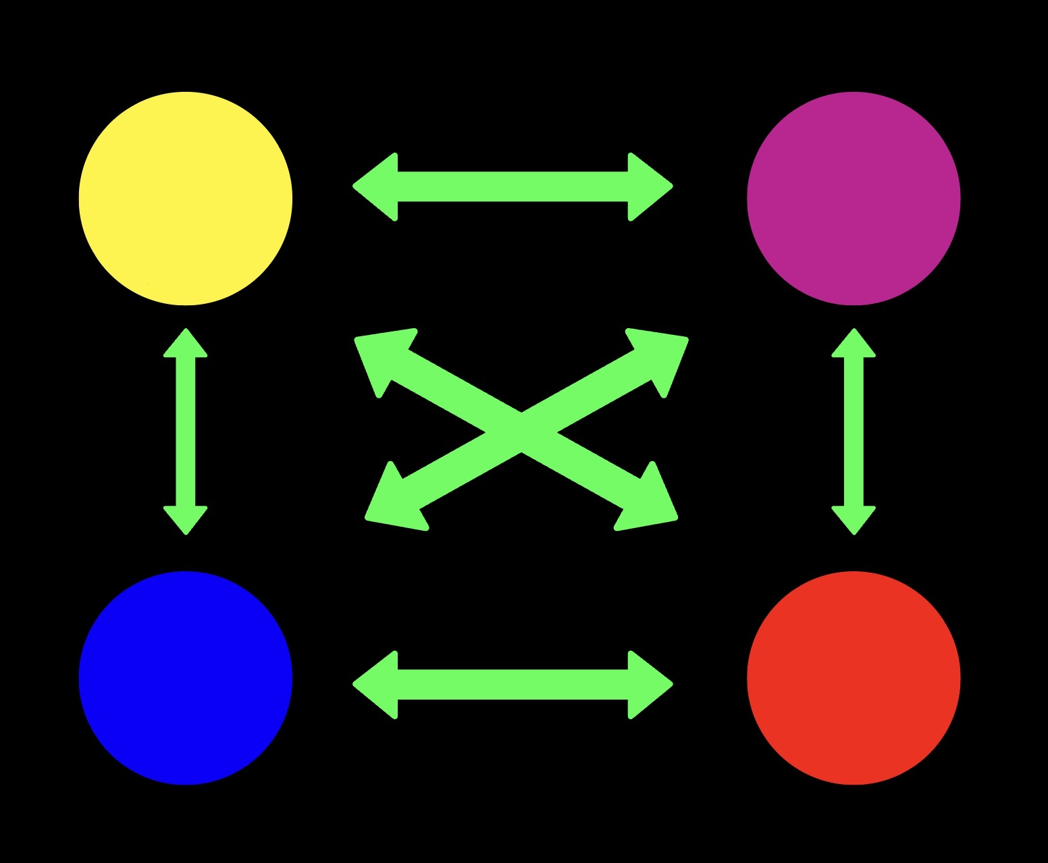
N-Body System

Slide 26
N-Body System
Starting With Newtonian Gravitation
$${\overset{⃗}{F}}_{i}=\overset{N}{\underset{\begin{aligned}j=1 \\ j≠i\end{aligned}}{∑}}\frac{Gm_{i}m_{j}}{r_{ij}^{2}}{\overset{⃗}{n}}_{ij}$$
Using Newton’s Second Law
$$\overset{⃗}{F_{i}}=m_{i}{\overset{⃗}{a}}_{i}$$
Extrapolating For Each Body
$${\overset{⃗}{a}}_{i}=\overset{N}{\underset{\begin{aligned}j=1 \\ j≠i\end{aligned}}{∑}}\frac{Gm_{j}}{r_{ij}^{2}}{\overset{⃗}{n}}_{ij}$$
Where For Each Body
$$i,j∈\{1,2,…,N\},i≠j,{\overset{⃗}{r}}_{ij}={\overset{⃗}{r}}_{j}-{\overset{⃗}{r}}_{i},r_{ij}=∥{\overset{⃗}{r}}_{ij}∥,{\overset{⃗}{n}}_{ij}=\frac{{\overset{⃗}{r}}_{ij}}{r_{ij}}$$

Slide 27
Refactored Results

Slide 28
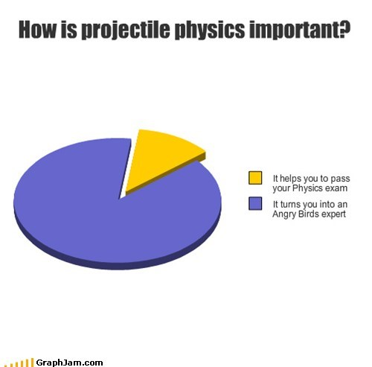
Single Body Baseline
We first test on Earth, and compare results with kinematics.
Once verified, we can test on other planets, masses, etc.

Slide 29
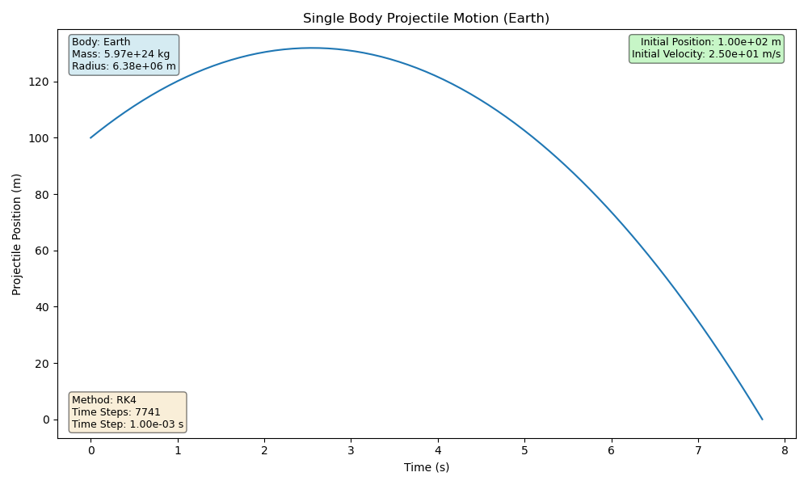
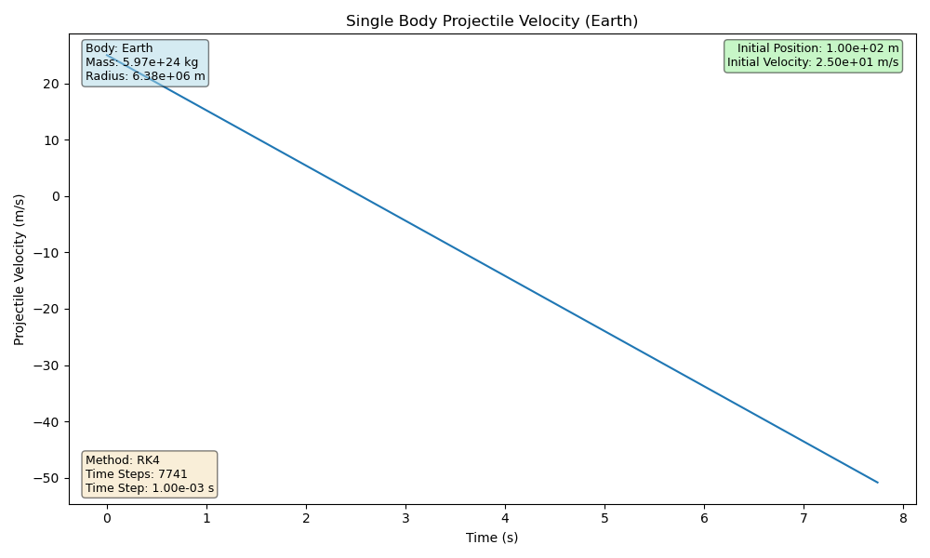
Single Body System On Earth
$$y_{0}=100(m),v_{y_{0}}=25(m/s),t=7.74(s),h=0.001(s)$$

Slide 30
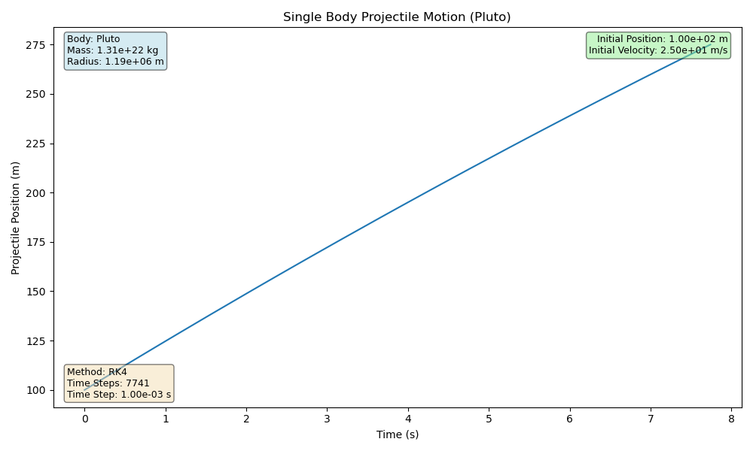
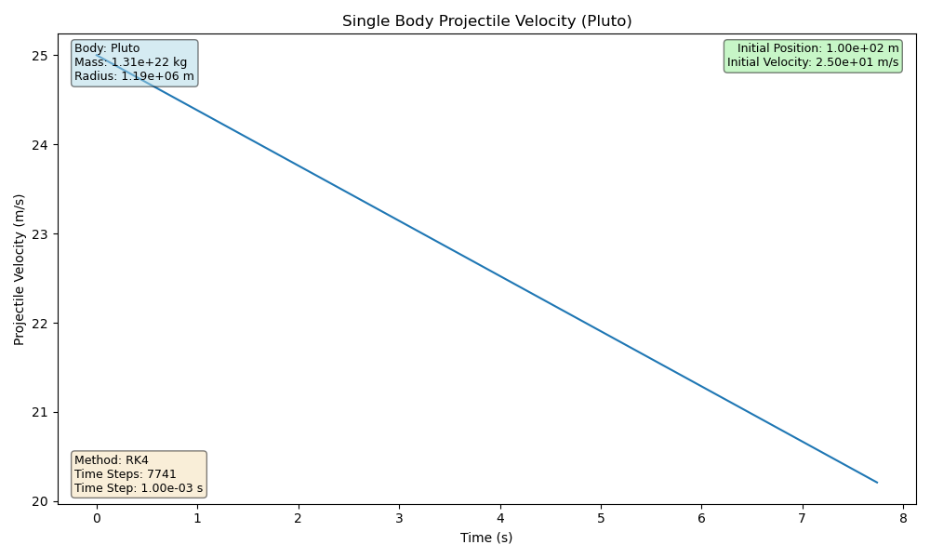
Single Body System On Pluto
$$y_{0}=100(m),v_{y_{0}}=25(m/s),t=7.74(s),h=0.001(s)$$

Slide 31
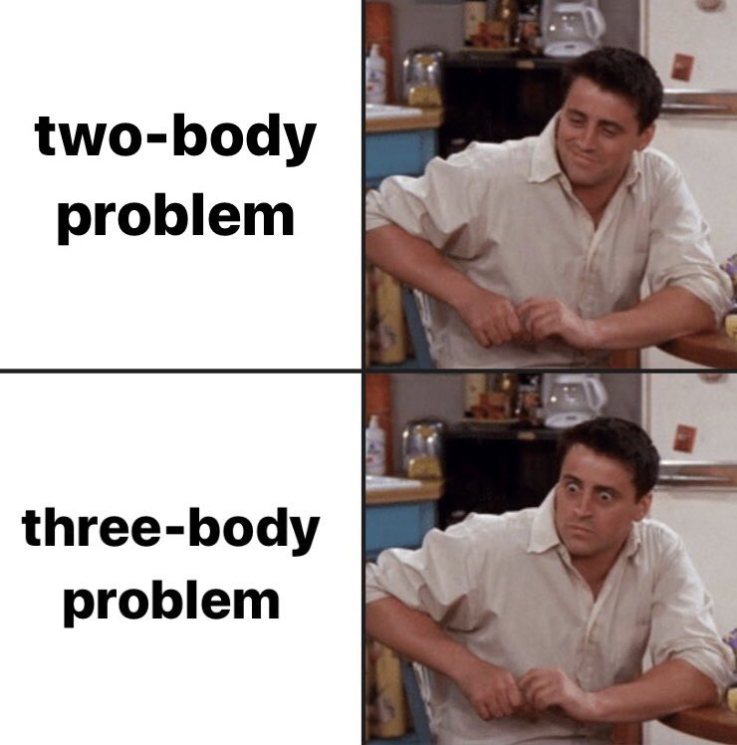
Two Body Baseline
Next Step In Complexity
We now test our numerical solvers with that of known systems.
After the results are verified, we can test more unknown systems.
And then move on to the three body problem.

Slide 32
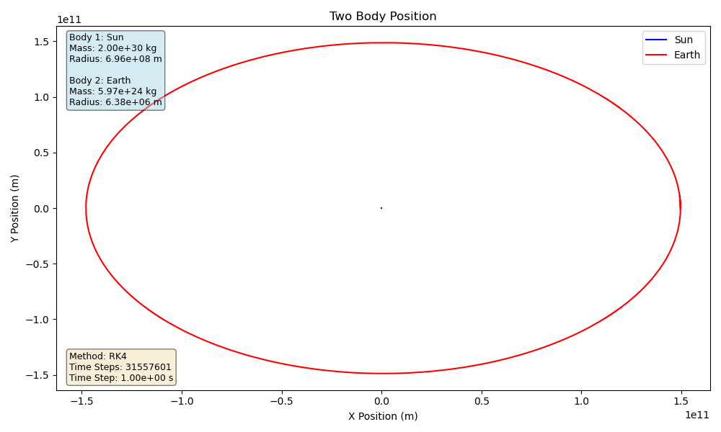
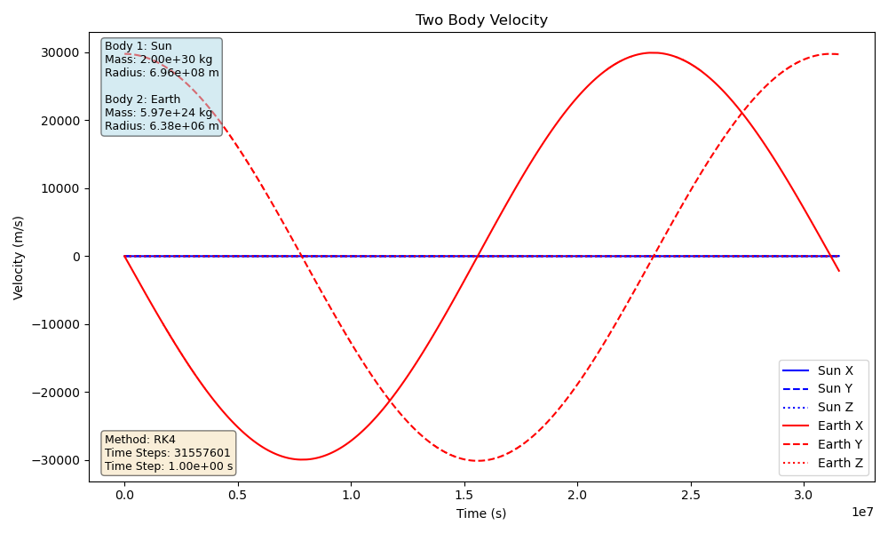
Two Body System Of Earth
One orbital period of Earth is plotted:
$$h=1(s),t=365.25(EarthDays),h_{T}=31,557,601$$

Slide 33
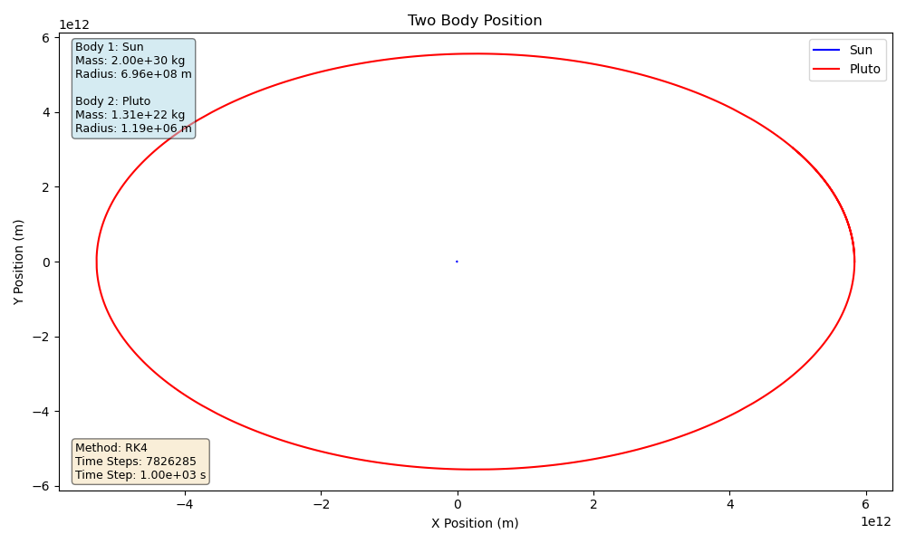
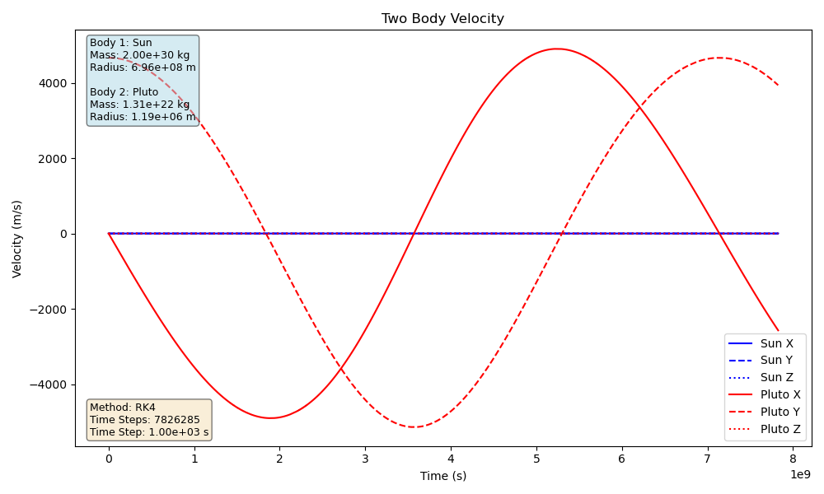
Two Body System Of Pluto
One orbital period of Pluto is plotted:
$$h=1,000(s),t=248(EarthYears),h_{T}=7,826,285$$

Slide 34
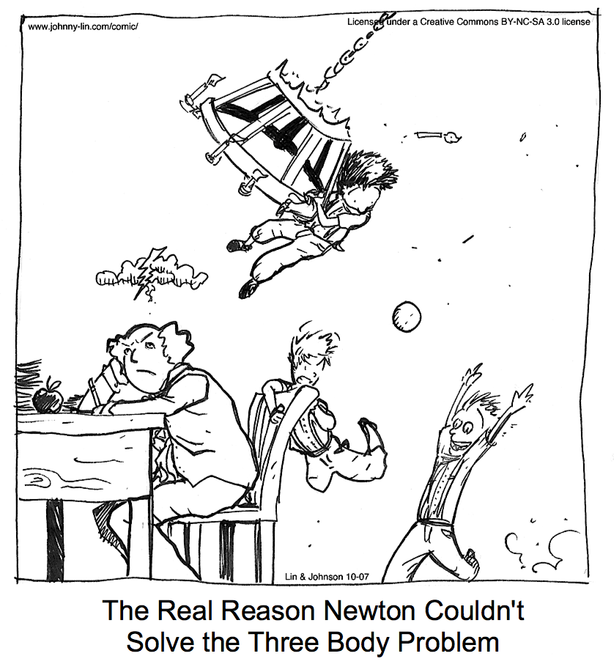
Three Body Baseline
Almost To N-Body
Knowing that the Two Body solvers are working, we now can begin to move on to a more complicated system.
We test with known orbits again, and then test with foreign systems.

Slide 35
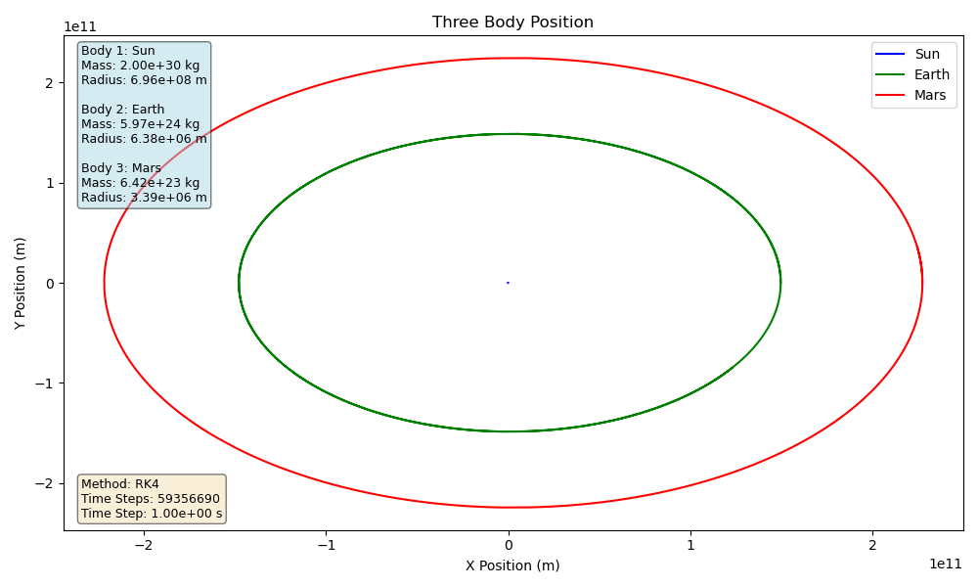
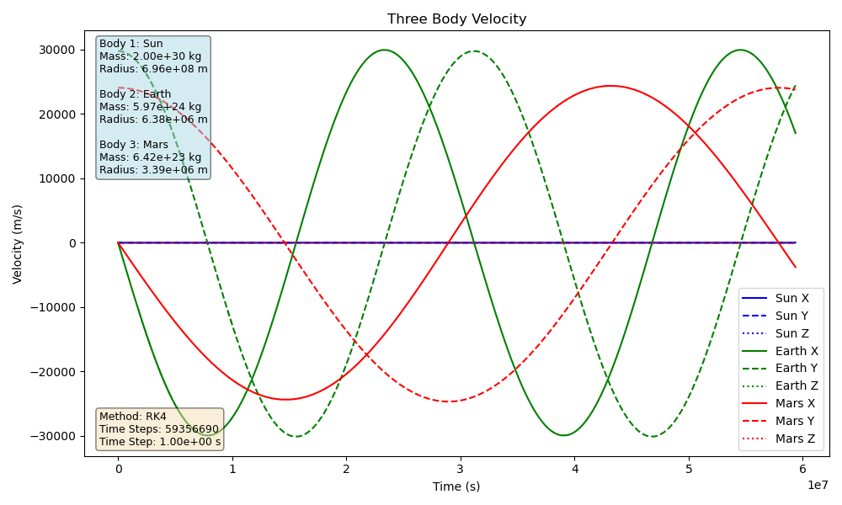
Three Body System - Sun, Earth, Mars
One orbital period of Mars Plotted:
$$h=1(s),t=687(EarthDays),h_{T}=59,356,690$$

Slide 36
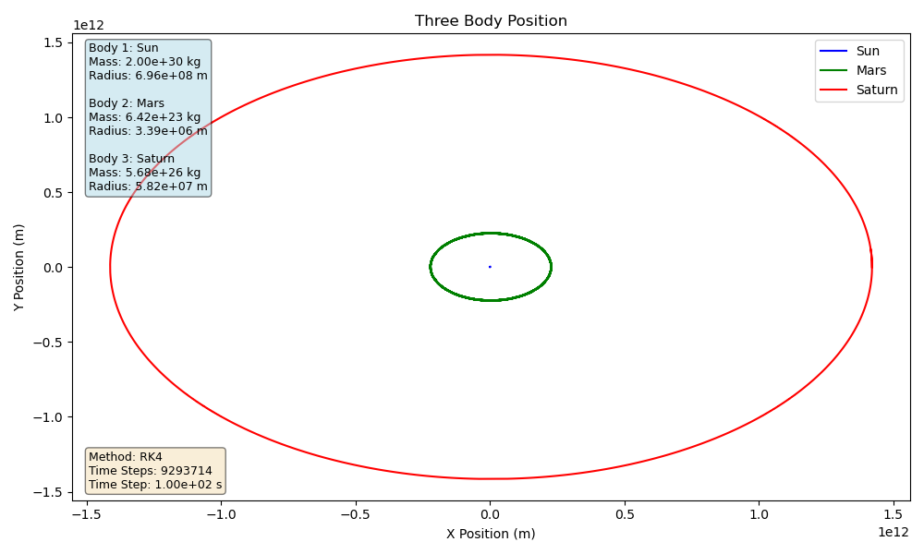
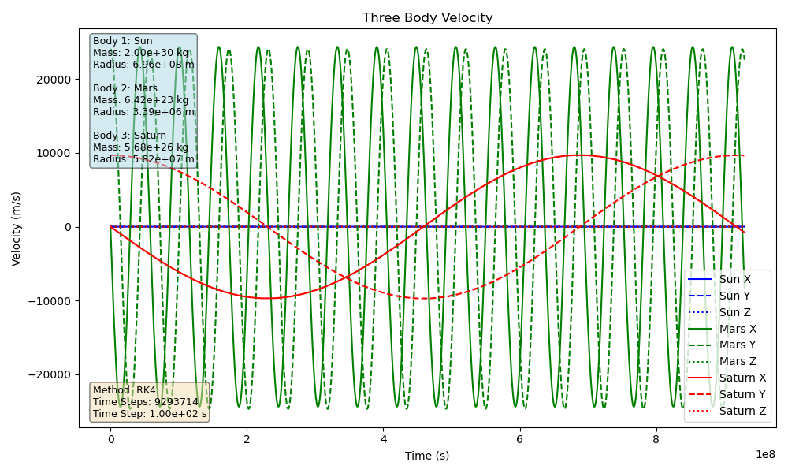
Three Body System - Sun, Mars, Saturn
One orbital period of Saturn Plotted:
$$h=100(s),t=29.45(Earthyears),h_{T}=9,151,705$$

Slide 37
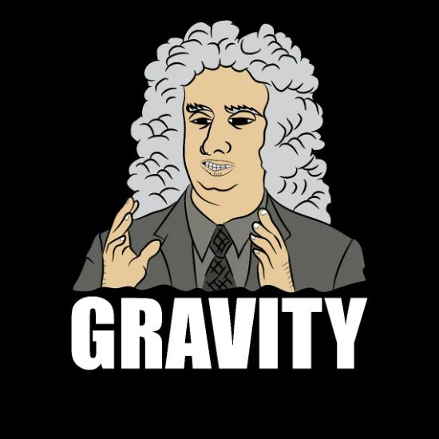
N-Body System
The Final Test
Now that we have verifiable (kinda) solutions from the Three Body system, we can move on to the most complex system for this problem.
Orbits of planets are plotted as well as random systems.

Slide 38
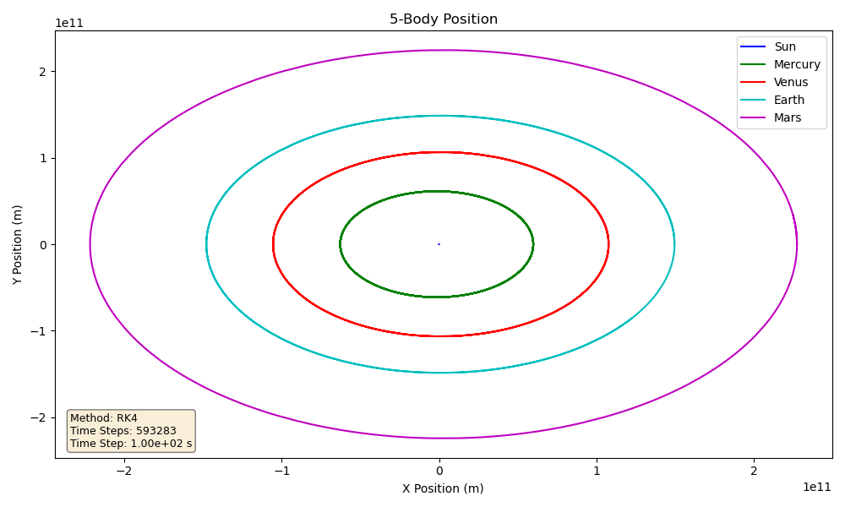
N-Body System - Sun To Mars
One orbital period of Mars is plotted along with all terrestrial planets:
$$h=100(s),t=687(EarthDays),h_{T}=593,283$$

Slide 39
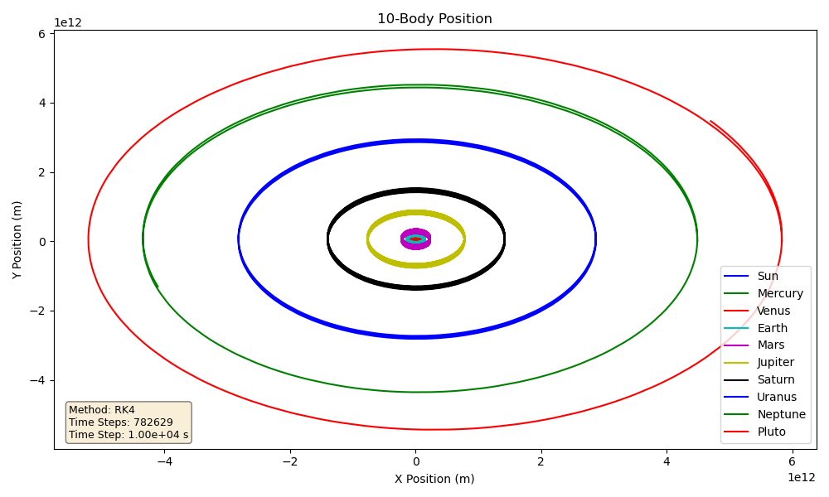
N-Body System - Solar System
One orbital period of Pluto is plotted with the 8 planets:
$$h=10,000(s),t=249(EarthYears),h_{T}=782,629$$

Slide 40
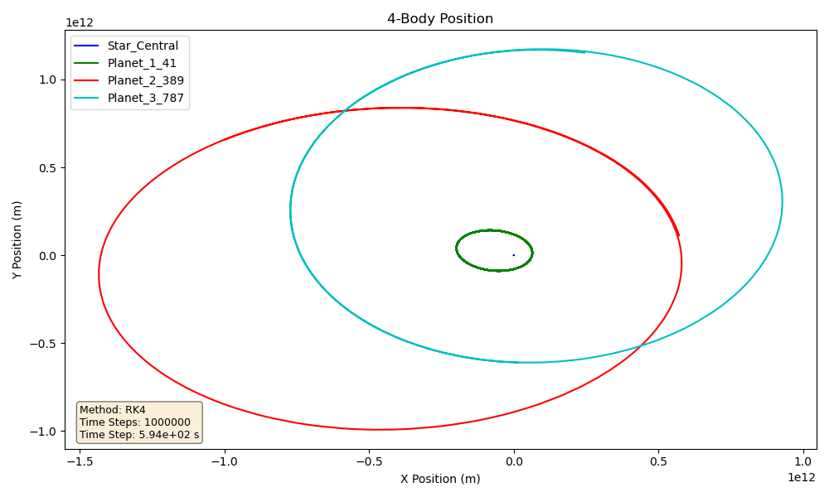
N-Body System - Random System 1
Random 4 Body System plotted:
$$h=594(s),t=18.82(EarthYears),h_{T}=1,000,000$$

Slide 41
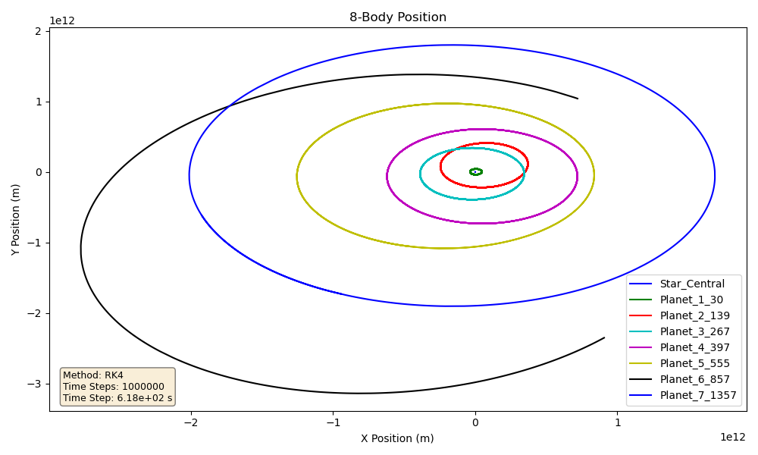
N-Body System - Random System 2
Random 8 Body System plotted:
$$h=618(s),t=19.58(EarthYears),h_{T}=1,000,000$$

Slide 42
Physics Informed Neural Network

Slide 43
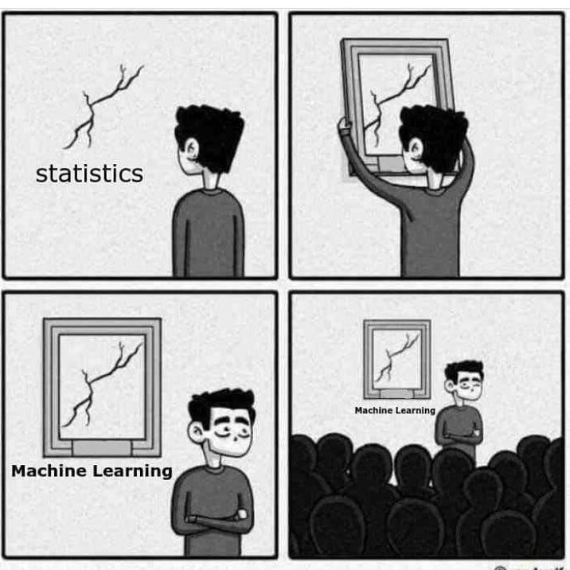
Machine Learning
With A PINN
PINNs as a whole
How it was implemented
The results

Slide 44
PINNs
At A High Level
What they are: A neural network trained to satisfy known physics (usually involves differential equations).
What they do: Typically learn a parameter from data, used to make inferences on system with learned parameter.
Why they are used: Often useful when the physics for a given system is trusted but measurements or something similar in a model is missing effects.
Benefits in data: They perform relatively well due to extra supervision in training, they can work with limited, noisier, or sparse data.
Challenges with them: Data production techniques, training time and refinement, they struggle with discontinuities, chaotic systems, long time horizons, etc.

Slide 45
What The Model Does
Predicta
Goal: Train a neural network to make the following prediction: Given the system “right now”, predict the acceleration at this moment.
Why acceleration: In a Single Body (projectile motion) system, we can use kinematics to predict position and velocity from this learned acceleration.
PINN-ness: Instead of trying to predict the entire trajectory from raw data, it predicts local dynamics with the learned acceleration of the system.
Main parameters fed: The model primarily trains on the following:
Initial position and velocity
Initial time, time step, and total time
Body’s mass, radius, initial position, initial velocity

Slide 46
How It Was Implemented
LibTorch MLP
Language: Entire data generation pipeline and machine learning model is written in C++.
Data generation: Random initial conditions were fed to RK4 solver to generate.
The randomly generated data is specific to a body (e.g. Earth, Mars, Jupiter, etc.)
Body specific models: From the body specific data, a body specific model is trained.
Training: For each new model, 800 “data points” are created for training, 100 for validation, 100 for testing.
Resuming training does not create new validation or test data points, only 800 for training.
Each session: One training session consists of 25 epochs:
Fresh models complete one epoch in about 60 seconds.
When resuming training, every 800 added training data points adds about 60 seconds to each epoch.

Slide 47
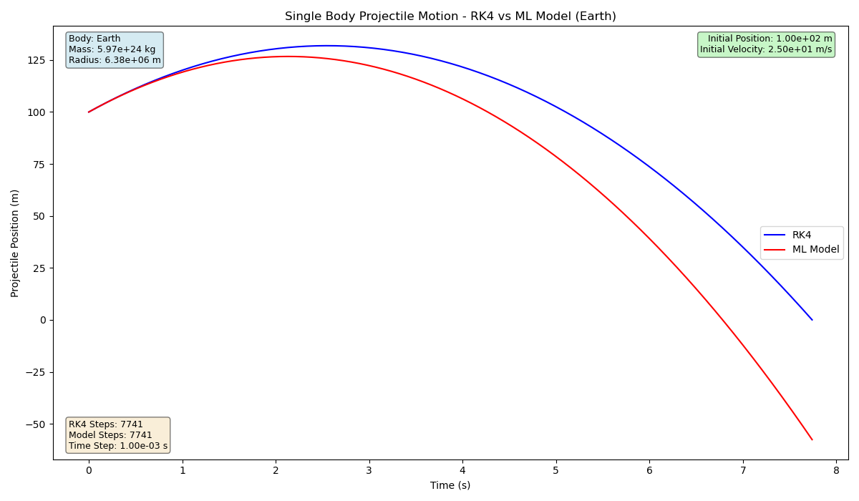
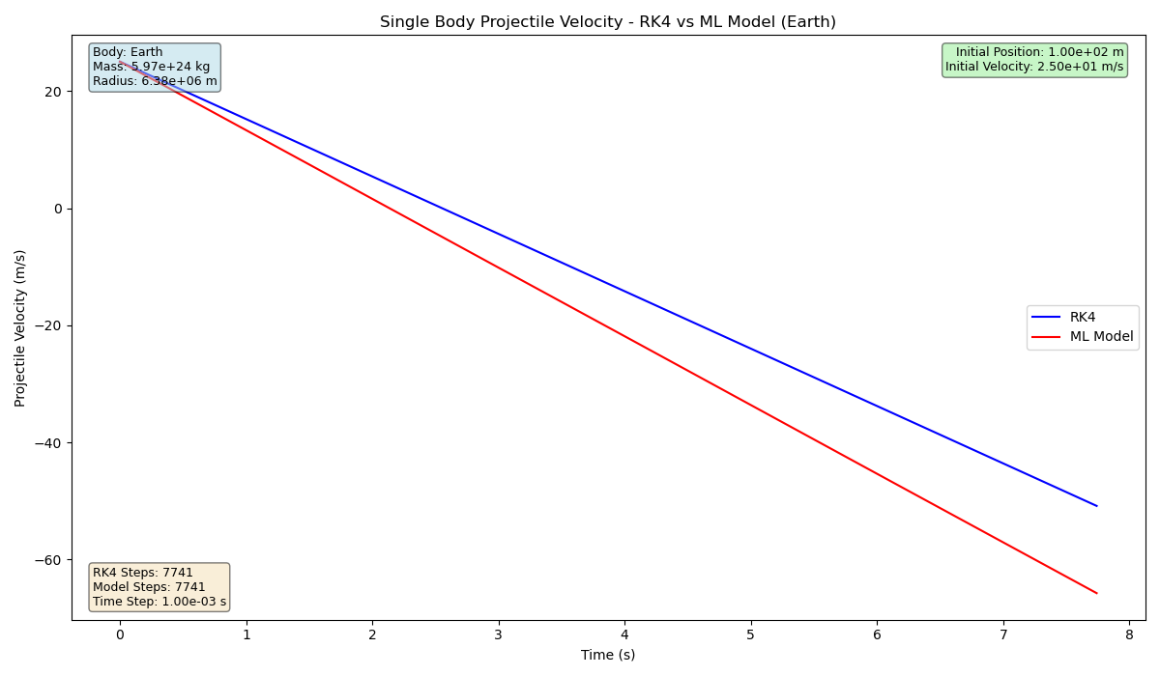
Prediction 1
Projectile launched from Earth, 1 training session
$$y_{0}=100(m),v_{y_{0}}=25(m/s),t=7.74(s),h=0.001(s)$$

Slide 48


Prediction 1
Projectile launched from Earth, 2 training sessions
$$y_{0}=100(m),v_{y_{0}}=25(m/s),t=7.74(s),h=0.001(s)$$

Slide 49
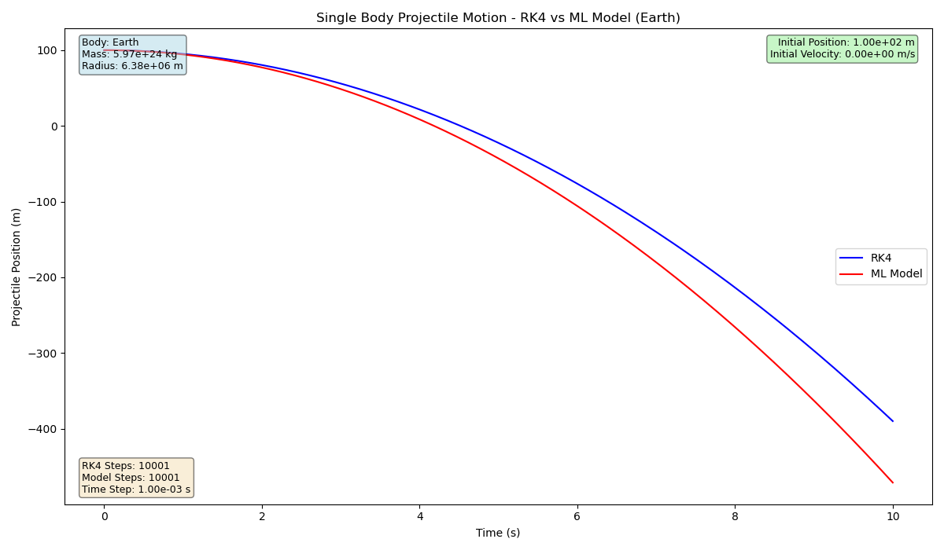
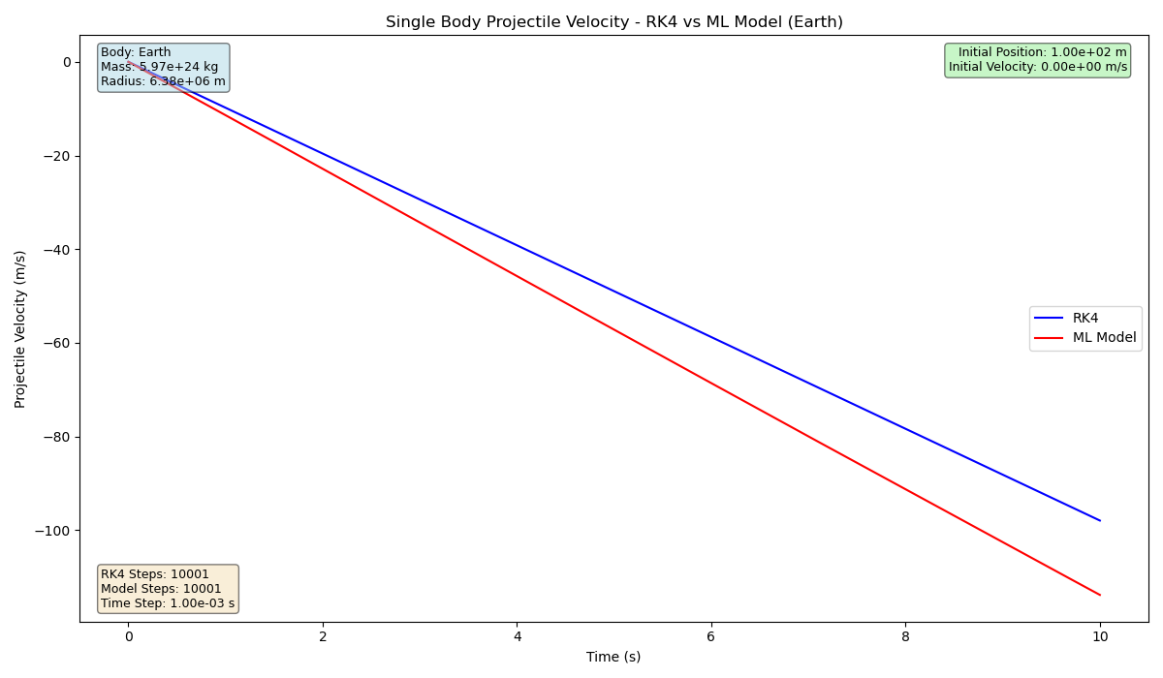
Prediction 2
Projectile launched from Earth, 1 training session
$$y_{0}=100(m),v_{y_{0}}=0(m/s),t=10.0(s),h=0.001(s)$$

Slide 50
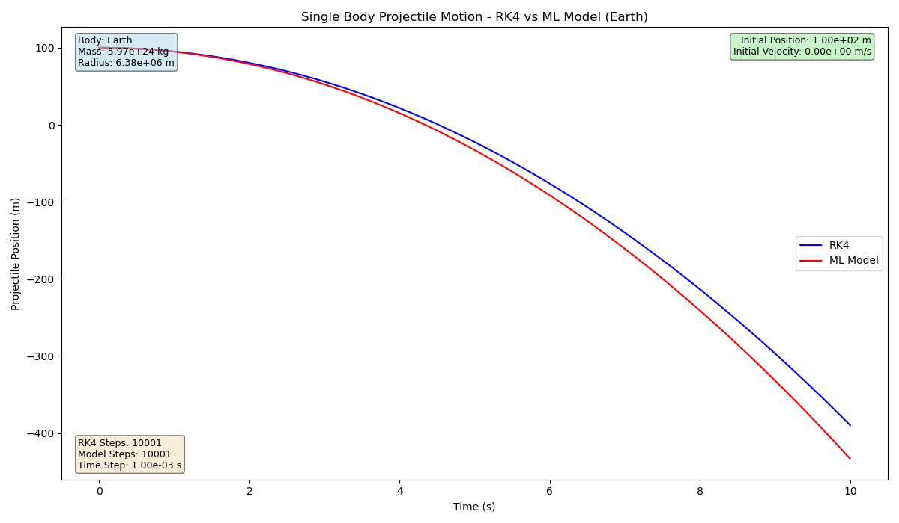
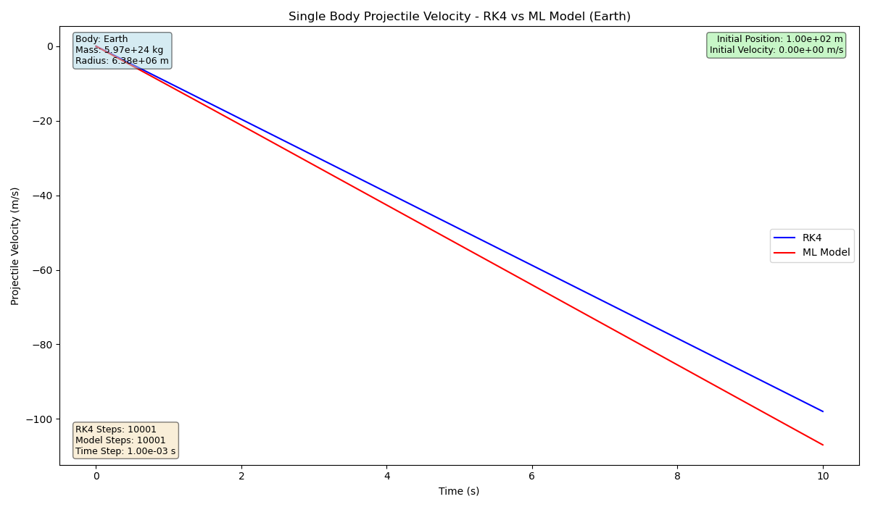
Prediction 2
Projectile launched from Earth, 2 training sessions
$$y_{0}=100(m),v_{y_{0}}=0(m/s),t=10.0(s),h=0.001(s)$$

Slide 51
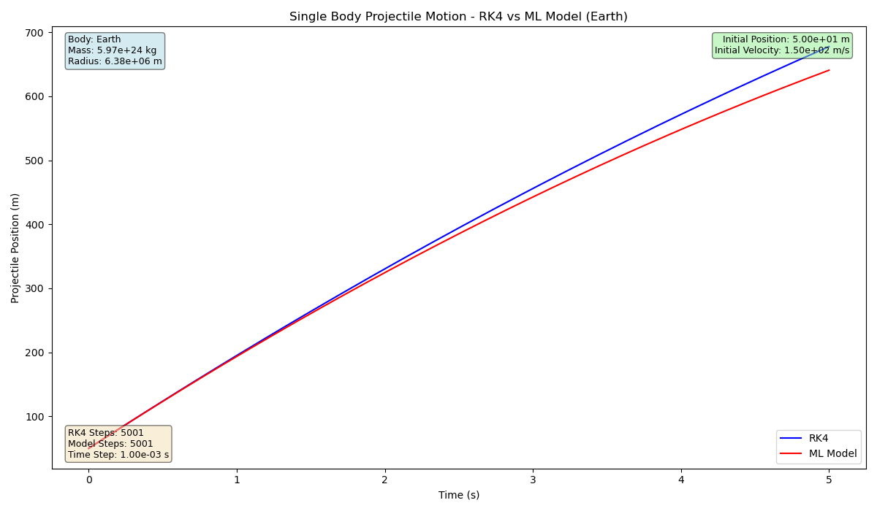
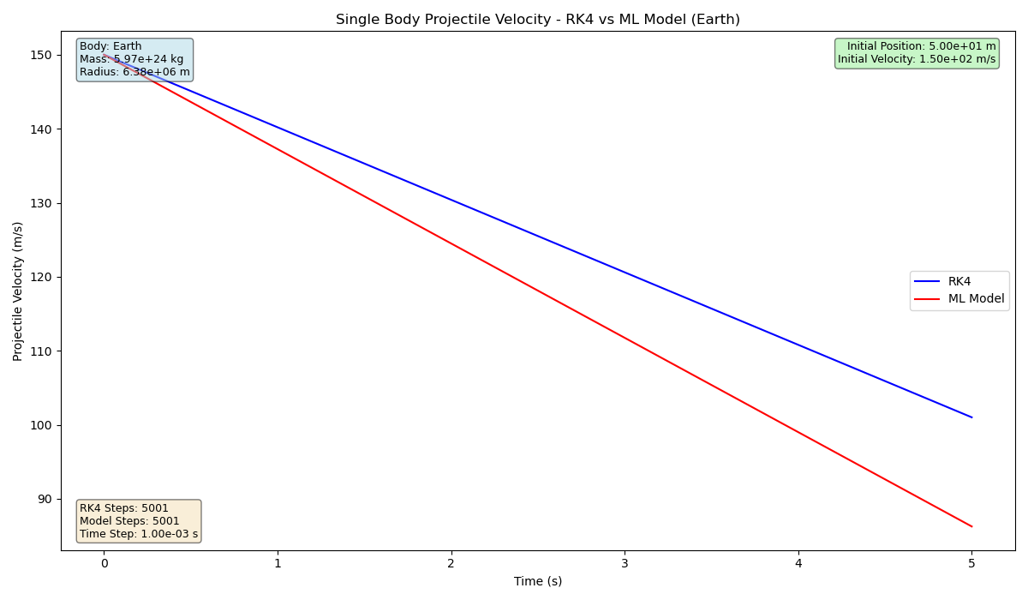
Prediction 3
Projectile launched from Earth, 2 training sessions
$$y_{0}=50(m),v_{y_{0}}=150(m/s),t=5.0(s),h=0.001(s)$$

Slide 52
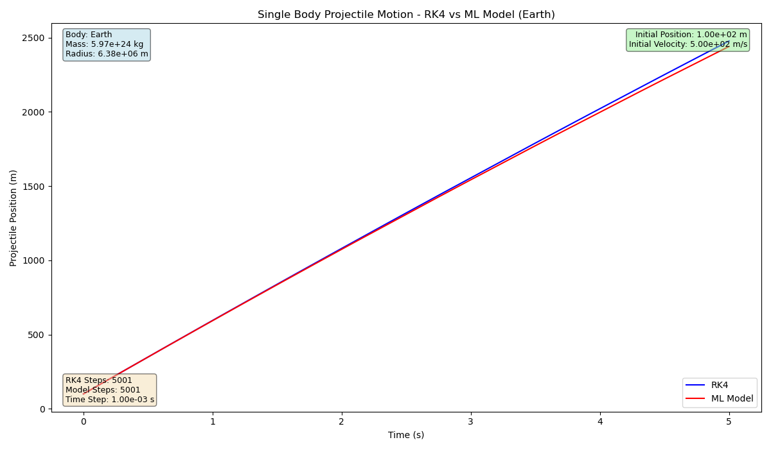

Prediction 4
Projectile launched from Earth, 2 training sessions
$$y_{0}=100(m),v_{y_{0}}=500(m/s),t=5.0(s),h=0.001(s)$$

Slide 53
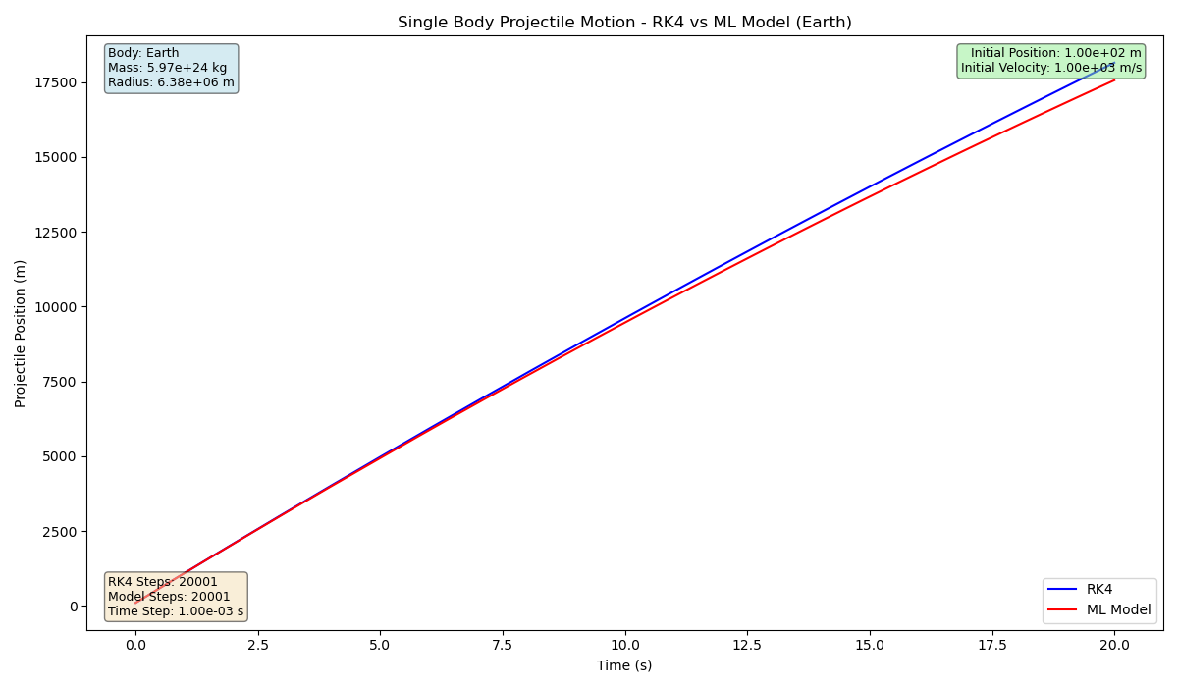
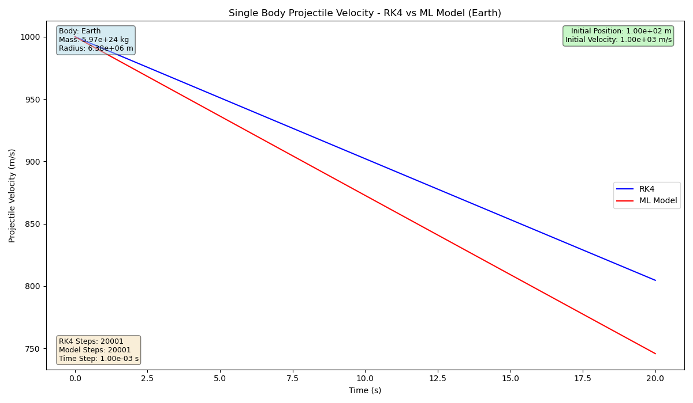
Prediction 5
Projectile launched from Earth, 2 training sessions
$$y_{0}=100(m),v_{y_{0}}=1000(m/s),t=20.0(s),h=0.001(s)$$

Slide 54
Conclusions

Slide 55
Final Thoughts
Numerical Methods
RK4: The Runge Kutta 4 method produces more stable trajectories / orbits compared to a more primitive method.
Method begins to struggle with higher number of bodies in N-Body System.
C++ vs. Python
C++: Significantly faster, easier to bundle as a single executable, can do almost everything compared to Python.
C++ has a library called LibTorch for ML training and third party API called matplotlibcpp.
Python: Very slow, has a harder time creating the same volume of data compared to C++.
Machine Learning
The Good: Model training is in a good state, program can reliably train and retrain existing models with improvements over sessions.
The “Bad”: There is currently only a model for the Single Body System, more code is needed for other systems.

Slide 56
Works Cited
Development:
GitHub Username: QuantumCompiler
GitHub Codebase: https://github.com/QuantumCompiler/Dynamics-Of-Celestial-Bodies (Predicta-CLI)
AI Companions: ChatGPT and GitHub Copilot
Projectile Motion PINN: https://github.com/maciejczarnacki/PINNs-projectile-motion
Neat Stuff:
Kaggle: https://www.kaggle.com/
PINN Paper: https://www.sciencedirect.com/science/article/abs/pii/S0021999118307125
Professional:
LinkedIn: Taylor Larrechea - https://www.linkedin.com/in/tlarrechea/

Slide 57
Questions

